Slide 1
Elevator Project
Ryan Hartman, Lucas Dos Santos, Ezra Perry

Slide 2
Motivation
Our motivation for this project was to improve an elevator’s overall response time as well as improve upon its overall operating speed.

Slide 3
Elevator Versions & Implementations
Rudimentary Elevator
Basic Elevator
Advanced Elevator

Slide 4
Rudimentary Elevator
Structures Used:
Queue - Stores elevator requests.
ArrayList - Stores passengers currently in the elevator.
Operation
Open doors.
Check for those wishing to board or exit.
Check for next request.
If on current floor, allow person to board.
Close doors and proceed to next floor.
If top or bottom floor is reached, reverse direction.

Slide 5
Basic Elevator
Structures Used:
Queue - Stores elevator requests.
ArrayList #1 - Stores elevator requests. (For advanced movement logic)
ArrayList #2 - Stores passengers currently in the elevator.
Operation: (See Figure #1 as needed)
Check for next request
Move these requests from the Queue to the ArrayList as a “known” request.
If the current floor has requests to board or exit, modify the ArrayList appropriately, but only if the passenger is wanting to move in the same direction that the elevator is.

Slide 6
Basic Elevator
Elevator then decides which direction to move next.
If no known requests and it is empty, the elevator idles.
Otherwise, if it has passengers, the elevator continues in its current direction.
However, if the elevator is empty and has known requests, it moves to the floor with the oldest known request.
Allows for a minimized wait time.

Slide 7
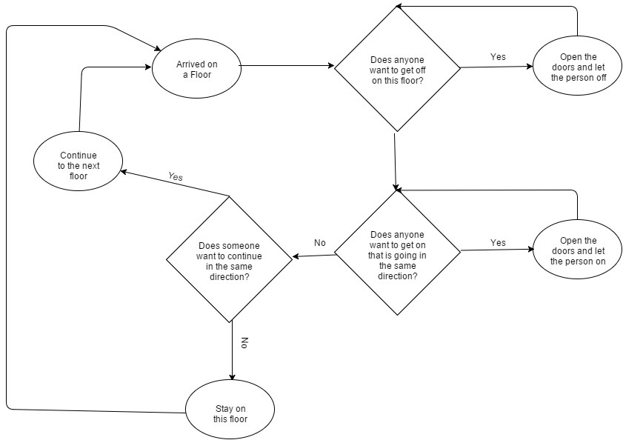
Basic Elevator - Flowchart
Figure 1: Basic Elevator Logic Flowchart

Slide 8
Results
Rudimentary & Basic
Comparison between the rudimentary and basic elevators.
The cost was measured as the time taken between the passenger request and the passenger being dropped off at their destination.
Total cost was calculated as the sum of individual costs for each request.
Trials were run with variable number of floors and constant number of requests, and variable number of requests with constant floor amounts.

Slide 9
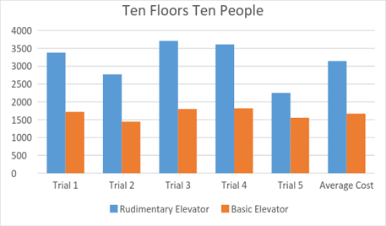
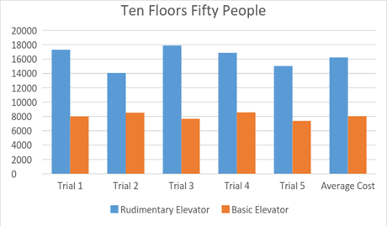
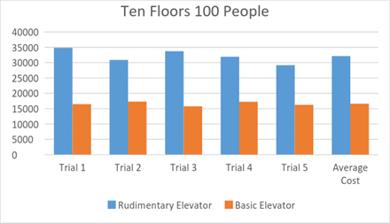
Figure 2: First test
Figure 3: Second test
Figure 4: Third test

Slide 10
Results Analysis
Rudimentary & Basic
For constant floors, the basic elevator performed twice as fast as the rudimentary implementation on average.
Trials were then conducted with variable numbers of passenger requests.

Slide 11
Figure 5: First test
Figure 6: Second test
Figure 7: Third test

Slide 12
Results Analysis
The same performance improvement still holds.
The basic implementation performs approximately twice as fast as its rudimentary counterpart.

Slide 13
Improving The Basic Elevator
From analyzing the results there was no specific area that the elevator appeared to struggle
While watching the visualization we noticed a key problem
Requests were not always being grabbed optimally
To fix this problem, we changed the implementation for the movement of the elevator, and how the elevator decided who to pick up

Slide 14
Advanced Elevator
Structures Used:
Queue - Stores elevator requests.
Priority Queue - Stores “known” elevator requests.
Allows for quicker data access versus a second ArrayList.
ArrayList - Stores passengers currently in the elevator.
Operation: (See Figure #8 as needed)
Check for unknown requests.
Supply these to the Priority Queue.
Check for passengers wanting to exit on current floor and let them out if needed.
Board passengers travelling in the same direction of the elevator (if they exist).

Slide 15
Advanced Elevator (Cont.)
Operation: (See Figure #8 as needed)
Otherwise, if it is empty, switch directions.
So long as the elevator has occupants, it will continue to move in its current direction.
If the elevator is empty and known requests exist in the Priority Queue, move towards the oldest request.
If it empty and no requests exist at that time, the elevator will idle at the last floor it has visited.

Slide 16
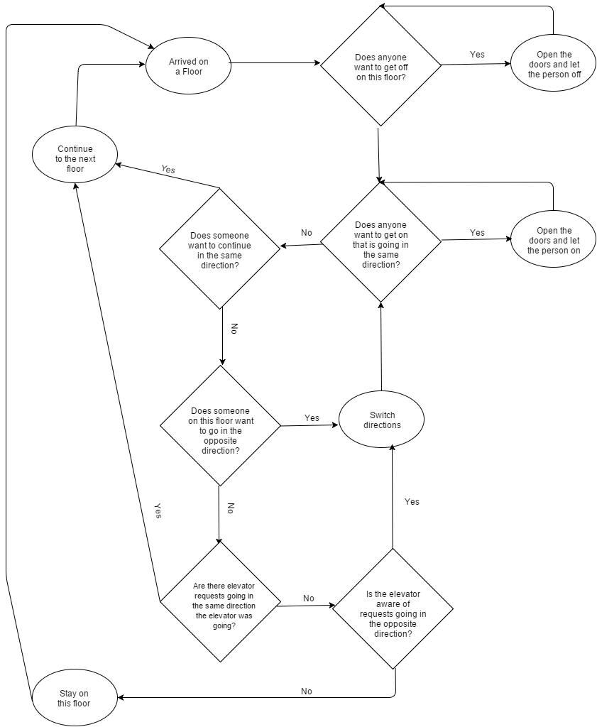
Figure 8: Advanced Elevator Logic Flowchart

Slide 17
Results
The same trials were then run for the advanced elevator implementation
This was done to compare overall performance between the three elevators

Slide 18
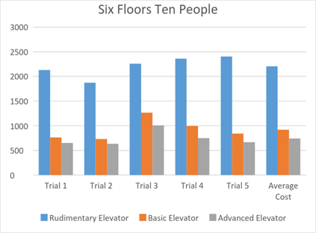
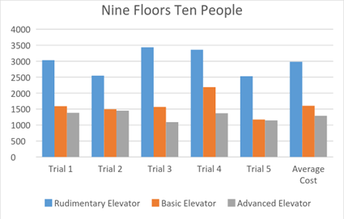
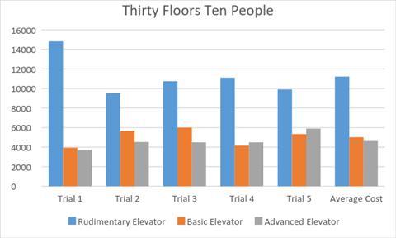
Figure 10: First test
Figure 11: Second test
Figure 12: Third test

Slide 19
Results Analysis
For a majority of test cases, the advanced elevator performed faster.
However in two test cases, the basic implementation was faster.
The total cost for the advanced elevator was 295 seconds faster, on average.

Slide 20
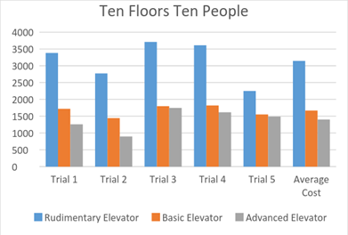
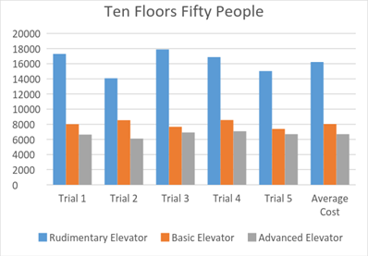
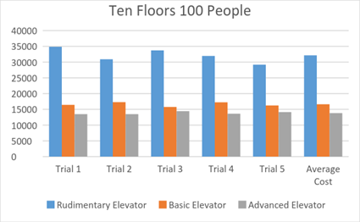
Figure 13: First test
Figure 14: Second test
Figure 15: Third test

Slide 21
Results Analysis
The advanced implementation outperformed the basic implementation on all trials.
On average it performed 2779 seconds faster
This shows that the amount of floors does not change elevator performance much, but number of requests makes the advanced elevator much faster.

Slide 22
Improvements for Real Life
Multiple Elevators
Requests distributed between them depending on which is closest and which is moving in the same direction as the request
Changes to Idle Behavior
Depending on time of day have elevator idle at different floors:
Midday - Middle floor, Morning - Ground floor

Slide 23
References
Elevators, Wikipedia
https://en.wikipedia.org/wiki/Elevator
Elevator Algorithm, Wikipedia
https://en.wikipedia.org/wiki/Elevator_algorithm
Elevator Puzzle, I-Programmer
http://www.i-programmer.info/programmer-puzzles/203-sharpen-your-coding-skills/4561-sharpenyour-coding-skills-elevator-puzzle.html
Cornell Elevator Project, Cornell
https://courses.cit.cornell.edu/ee476/FinalProjects/s2007/aoc6_dah64/aoc6_dah64/

